Slide 1

Microsoft Azure Stack Hub Support
Azure Stack Hub Troubleshooting and Support
This work is licensed under a Creative Commons Attribution - ShareAlike 4.0 International Public License

Slide 2
Agenda
Azure Stack Hub Support Model
Integrated support experience
Lifecycle & Support Policy
What might happen during a support case?
Diagnostics flow
Obtaining Azure Stack Hub Logs
Privileged Endpoint
Troubleshooting common issues

Slide 3
Azure Stack Hub Support Model

Slide 4
Software
Delivering Azure Stack Hub as an Integrated System
Hardware
Support
Azure Stack Hub is an extension of Azure
Services

Slide 5
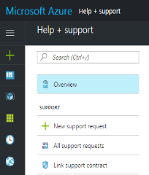


Integrated support experience
Azure-consistent support experience
no matter who you need support from
Coordinated escalation and resolution process
Cloud services support delivered by Microsoft
Existing Azure support or Premier Support contract
System support delivered by hardware partners
System support contract with hardware partners
Microsoft frontline support
Coordinated escalation and resolution process
Customer calls either vendor
Hardware partner frontline support

Slide 6
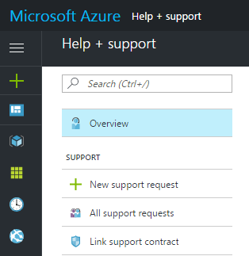
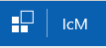


Integrated support experience
Microsoft support case in MSSolve
Microsoft frontline support
Azure Stack Hub SWE team
Analytics Tool
Case exchange
Helen Portal – Control Access
Customer calls either vendor
Partner Support case
Hardware partner frontline support

Slide 7
Scenario-based support boundary
The hardware partner owns (and should be called first for):
All hardware and HW partner-branded SW including HLH related issues.
Ex: If a server or disk or NIC is reported as faulty by the hardware monitoring tool.
Deployment, driver and firmware update, and FRU (field replacement unit) issues.
Ex: If a professional service engineer runs into onsite deployment failures Hardware vendor owns T1/T2 support and escalates to MSFT for T3 support.
Ex: If a customer runs into firmware update issues. Hardware vendor owns resolution.
For everything else, Microsoft or the Cloud Solution Provider should be called first. CSP will own the Tier 1 and 2 support, back-stopped by Microsoft for tier 3 support.

Slide 8
How to submit a support request (SR)
Enterprise customers go to the Azure portal
http://portal.azure.com and click on Help +Support
Need a valid Azure subscription and Support Plan (Standard, Pro-direct or Premier)
Support can also be initiated directly from Azure Stack Hub Administration portal
Doing this on an ASDK opens the forums
CSP’s use the Microsoft partner portal
https://partner.microsoft.com/en-us/support
Need mpn_id and password.
The process to open a ticket for Azure /Azure Stack Hub support is here
Having Issues?
Contact https://partner.microsoft.com/en-US/support/contact-support

Slide 9
What Might Happen During a Support Case?

Slide 10
Information required during support incidents
When an incident is created, the following information will be required to establish support:
Issue Description Describe the issue in detailed including what triggered the event
Customer Impact statement Provide the impact details for the issue.
Affected components Outline the affected components such as Storage, VMM, or Forwarding Gateway
Logs Provide any error details such as memory dumps, error event logs and screenshots.

Slide 11
What happens if I can’t use the actions?
Example Scenarios: Portal, ARM, Fabric Resource Provider, Directory Service or Storage are offline?
This account is like the server recovery console account in Windows
PS only
JEA
JEA
Service Provider
Machine
Privileged Endpoint
GMSA Domain Admin Account
Infrastructure Role Instances
Microsoft Support
Receives Diagnostic Package
Provides 2nd Phase for Two Way Factor Authentication
Shadows Azure Stack Hub troubleshooting ( Screen Sharing)
Guides Service Provider
Service Provider
1. Create Diagnostic Package
2. Start Unlock Process
3. Receives 2nd Phase Key from Support
4. Drives all input activity

Slide 12
Privileged Endpoint

Slide 13
Privileged Endpoint
Some problems might require a look inside the Azure Stack Hub fabric
There is no direct access to the VMs and/or Hyper-V hosts of the Azure Stack Hub fabric
There is a privileged endpoint (PEP) for emergency operations
Access to this privileged endpoint needs the CloudAdmin account
The PEP can only be elevated in cooperation with Microsoft support

Slide 14
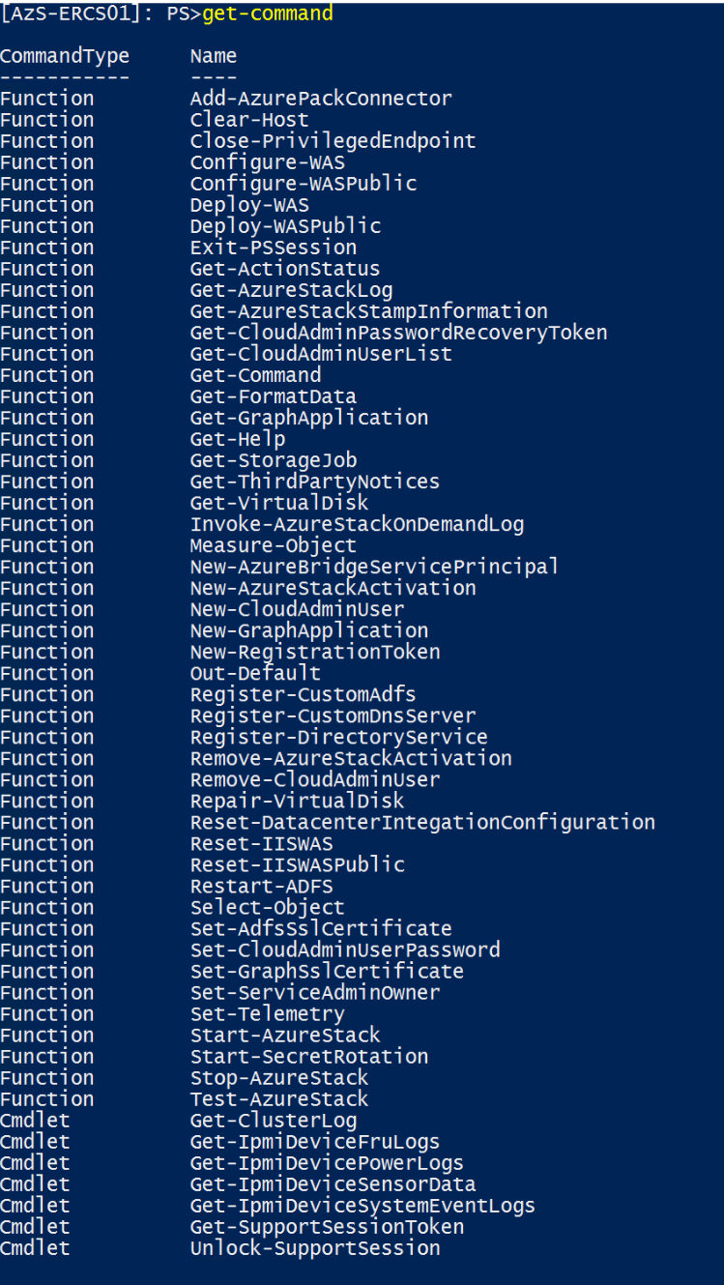
Privileged Endpoint
Preconfigured PowerShell Endpoint
Just enough capabilities to perform basic tasks
Restricted set of commands
Low Privileged account used to access
PowerShell in 'no language mode'
No Scripting is allowed
Can perform various tasks
Collect Diagnostic Logs
Perform Post-integration tasks e.g. AD FS, DNS Forwarders, Certificate rotation
Start, Stop and Test-AzureStack
Work with support to unlock the system

Slide 15
Privileged Endpoint
Access the Endpoint
Initial access through IP address until DNS is setup
Get address from OEM in JSON file “AzureStackStampDeploymentInfo”
Access through a hardened virtual machine running on top of the Hardware Lifecycle Host (HLH) or Privileged Access Workstation (PAW).
Don't use the Hyper-V host of the HLH as jump box
Establish Trust
Cmdlets
Exit PSSession
Enter-PSSession

Slide 16
Privileged Endpoint on HLH or PAW
# ESTABLISH TRUST
# Get ERCS addresses below from AzureStackStampInformation.json
winrm s winrm/config/client '@{TrustedHosts="w.x.y.z, w.x.y.z+1, w.x.y.z+2"}'
# Get Cloud Admin Credentials
$cloudadmincred = Get-Credential
# Create PSSession
$ErcsVmIP = "w.x.y.z, w.x.y.z+1, w.x.y.z+2"
$session = New-PSSession -ComputerName $ErcsVmIP -ConfigurationName PrivilegedEndpoint –Credential $cloudadmincred
# Enter PEP to run cmdlets
Enter-PSSession $session

Slide 17
Import PEP commands on local machine
# ESTABLISH TRUST
# Get ERCS addresses below from AzureStackStampInformation.json
winrm s winrm/config/client '@{TrustedHosts="w.x.y.z, w.x.y.z+1, w.x.y.z+2"}'
# Get Cloud Admin Credentials
$cloudadmincred = Get-Credential
# Create PSSession
$ErcsVmIP = "w.x.y.z, w.x.y.z+1, w.x.y.z+2"
$session = New-PSSession -ComputerName $ErcsVmIP -ConfigurationName PrivilegedEndpoint –Credential $cloudadmincred
# Enter PEP to run cmdlets locally
Import-PSSession $session

Slide 18
Privileged Endpoint
Unlock the System
Elevation of the Privileged Endpoint
If there is no other way to resolve the issue in the portal or through the PEP cmdlets
This exposes the underlying infrastructure by granting network access to all VMs and Hyper-V nodes
Domain Admin level rights are granted for the session
All Actions during the session are logged

Slide 19
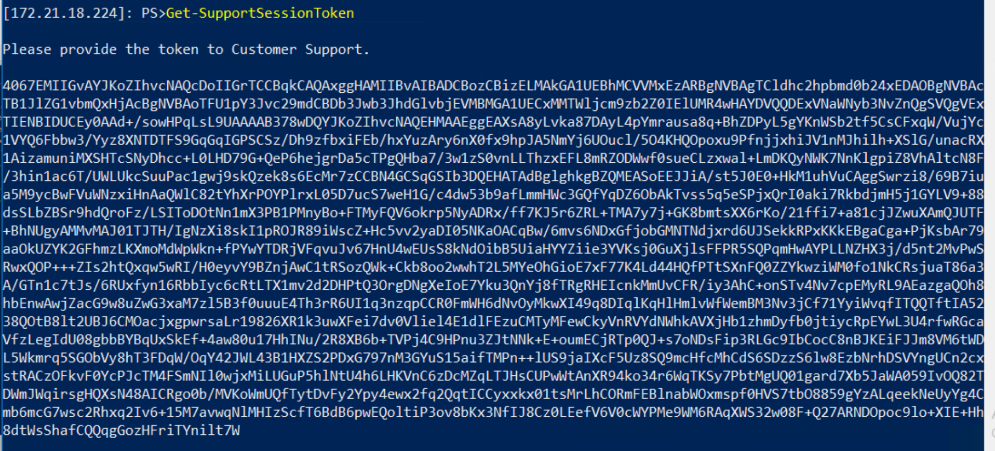
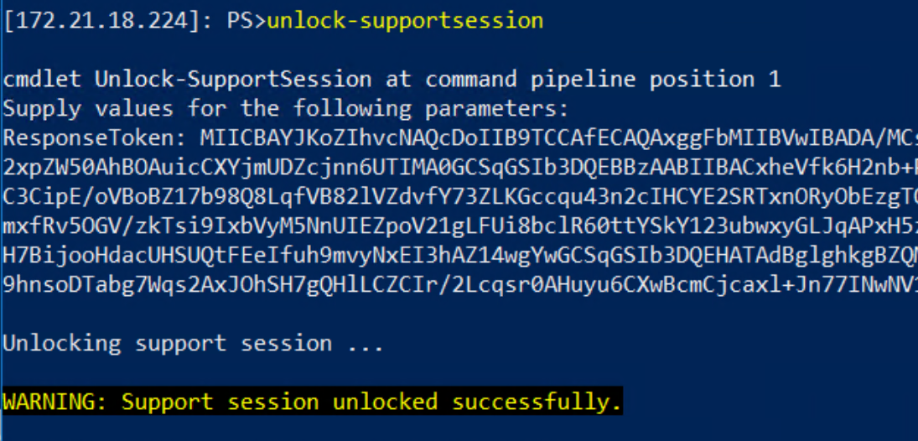
Privileged Endpoint
Unlock the System
Customer retrieves a Support Token for MS Support
Get-SupportSessionToken
MS Support gives a response key back to the customer
Unlock-SupportSession –ResponseToken “Unlock Token”
When done run
Close-PrivilegedEndpoint

Slide 20
Get-AzureStackLog

Slide 21
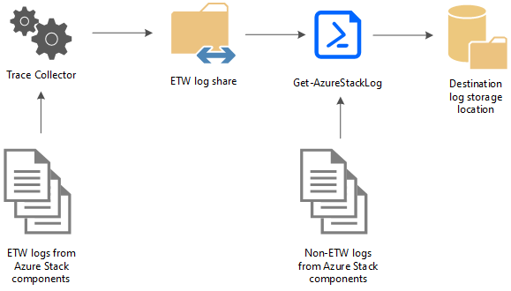
Get-AzureStackLog
Command is used to collect all or specific logs from Azure Stack Hub components
All logs are saved a user-defined UNC Path as zip files
Get-AzureStackLog is available on the (locked) Privileged Endpoint
Get-AzureStackLog –OutputSharePath \\path\of\your\choice -OutputShareCredential $cred

Slide 22
Get-AzureStack additional information
Additional parameters
If the FromDate and ToDate parameters are not specified, logs are collected for the past four hours by default.
The TimeOutInMinutes parameter sets the timeout for log collection. Default is 150 (2.5 hours)
Dump file log collection is disabled by default. To enable it, use the IncludeDumpFile switch parameter.
Get-AzureStackLog_Output.log
A file called Get-AzureStackLog_Output.log is also created in the folder that contains the zipped log files
This file is a log of the command output, which can be used for troubleshooting problems during log collection
Important Information
System and Event logs for the infrastructure VMs are collected in the VirtualMachines role
System and Event logs for the physical hosts are collected in the BareMetal role
Failover Cluster and Hyper-V event logs are collected in the Storage role
ACS logs are collected in the Storage and ACS roles

Slide 23
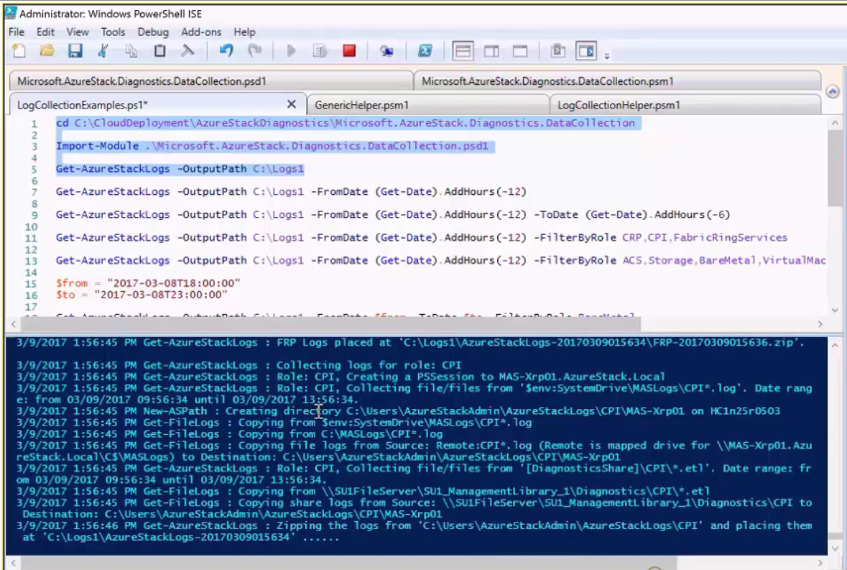
Getting Get-AzureStackLog data
The default grab is all logs for the past 4 hours (default)
This can be adjusted by adding the –FromDate & -ToDate switches
Logs can be filtered by using the –FilterByRole switch

Slide 24
Get-AzureStackLog filtering – How we get the roles we need
Example: Get-AzureStackLog -OutputSharePath "<path>" -OutputShareCredential $cred -FilterByRole VirtualMachines,BareMetal
ACSMigrationService | ACSMonitoringService | ACSSettingsService
ACS | ACSFabric | ACSFrontEnd
ACSTableMaster | ACSTableServer | ACSWac
ADFS | ASAppGateway | BareMetal
BRP | CA | CPI
CRP | DeploymentMachine | DHCP
Domain | ECE | ECESeedRing
FabricRing | FabricRingServices | FRP
Gateway | HealthMonitoring | HRP
IBC | InfraServiceController | KeyVaultAdminResourceProvider
KeyVaultControlPlane | KeyVaultDataPlane | NC
NonPrivilegedAppGateway | NRP | SeedRing
SeedRingServices | SLB | SQL
SRP | Storage | StorageController
URP | UsageBridge | VirtualMachines
WAS | WASPUBLIC | WDS

Slide 25
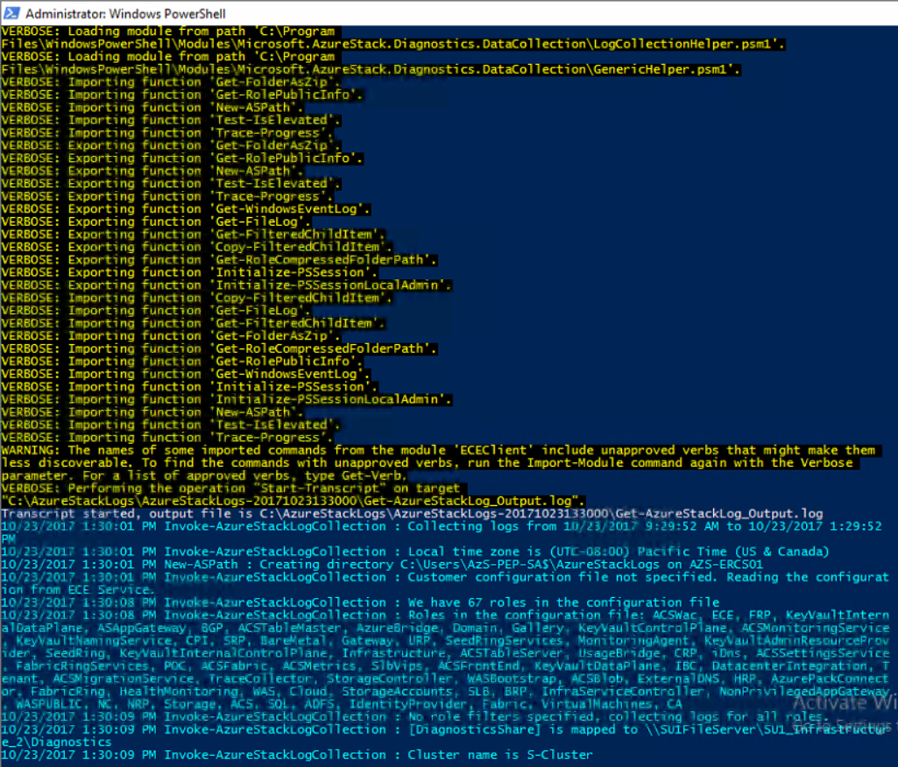
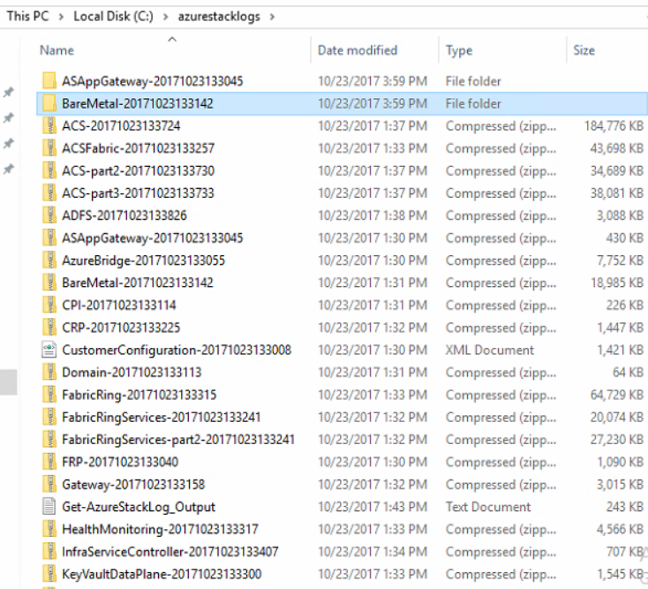
Get-AzureStacklog data collection
The data is collected into the selected location
The data dump is a collection of .Zip file that extracted for analysis

Slide 26
Troubleshooting
Common Issues

Slide 27
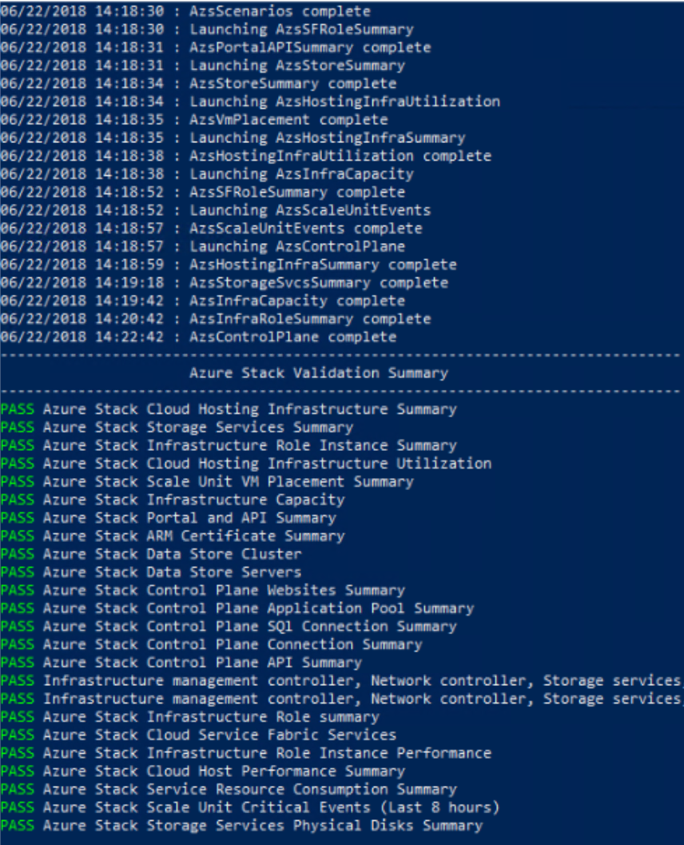
Azure Stack Hub validation
Test-AzureStack
When you have an issue, contact Microsoft Customer Services Support
Support may ask you to run Test-AzureStack from your management node
The validation test can isolate common failures.
Support can then analyze the detailed logs, focus on the area where the error occurred, and work with you in resolving the issue
You should also use Test-AzureStack to check your system readiness before installing updates or hotfixes

Slide 28
What does Test-AzureStack check?
You can use this command to run infrastructure tests or cloud scenario tests against your Azure Stack Hub.
Cloud scenario tests include:
Creating resource groups
Creating plans / Creating offers
Creating storage accounts
Creating a virtual machine
Perform blob operations using the storage account created in the test scenario
Perform queue operations using the storage account created in the test scenario
Perform table operations using the storage account created in the test scenario
Note: Cloud scenarios require cloud administrator credentials

Slide 29
Known issues
Log collection tool takes a long time to run
Check progress in the PS window to make sure tool is running.
You can also track progress in Get-AzureStackLogs_output.log
Date-time and/or role filters can be used to limit the total number of logs collected
Get-AzureStackLog did not collect logs for some roles
This usually happens when there are no logs found that match the date range specified
PowerShell window disappeared while the tool was running
You might have run out of disk space! Check the command output in Get-AzureStackLog_output.log

Slide 30
Other common issues
Resource Providers not registered
When connecting to tenant subscriptions with PowerShell, you will notice that the resource providers are not automatically registered. Use the Connect module, or run the following command from PowerShell (after you install and connect as a tenant):
Get-AzureRMResourceProvider | Register-AzureRmResourceProvider
One current example:
Create Azure Functions before a storage account is ever created
Functions will fail
Fix -> manually enable storage resource provider , then it will work

Slide 31
Questions?

